Slide 1
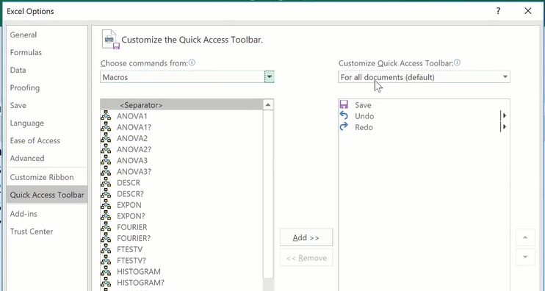
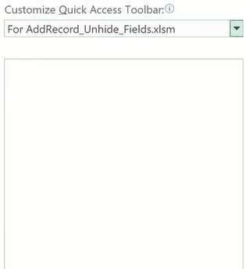
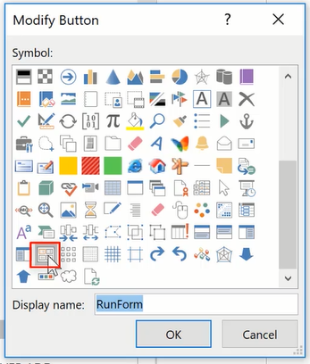
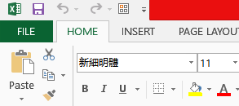
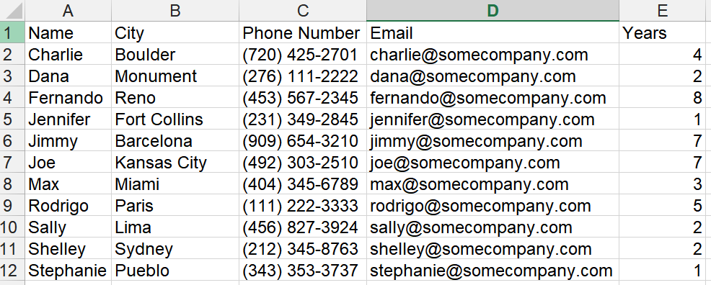
Useful Techniques
Instead of putting a Run Form Button in the Worksheet, we can add the RunForm Button in the Quick Access Bar
Methods to Count Rows and Columns
Standard Method for whole column:
Dim nr as integer
nr = WorksheetFunction.CountA(Columns(“A:A”))
‘This counts the whole column
Count rows below the first row:
Range(“A1”).Select ‘A1 becomes ActiveCell
Dim i As Integer
Do
i = i + 1
If IsEmpty(ActiveCell.Offset(i, 0)) Then Exit Do
Loop
There are i - 1 rows under the first row
Standard Method to count columns (i) before we encounter an empty cell
Range("A1").Select
Do
i = i + 1
If IsEmpty(ActiveCell.Offset(0, i - 1)) Then Exit Do
Loop
Alternatively count all the filled cells in a whole row
Dim nc as integer
nc = WorksheetFunction.CountA(Rows(“1:1”)) or
nc = WorksheetFunction.CountA(Rows(1))

